Slide 1



TRAFFIC MANAGEMENT
PHASE – 4
SUBMITTED BY…
M.EVANGELIN
R.KAVIYA
B.SNEHA
G.SUBULAKSHMI

Slide 2
TRAFFIC CONTROL
Based on the real – time data, traffic lights, electronics signs, and variable message boards can be adjusted to regulate traffic flow.
For example, traffic signals may be synchronized to reduce congestion during rush hours.

Slide 3
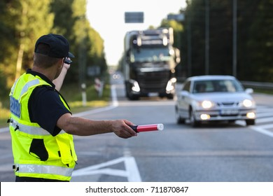
Traffic control

Slide 4

INCIDENT MANAGEMENT
When accidents, road closures, or other incidents occur, real – time traffic management systems can help reroute traffic and deploy emergency services quickly to minimize disruption.

Slide 5
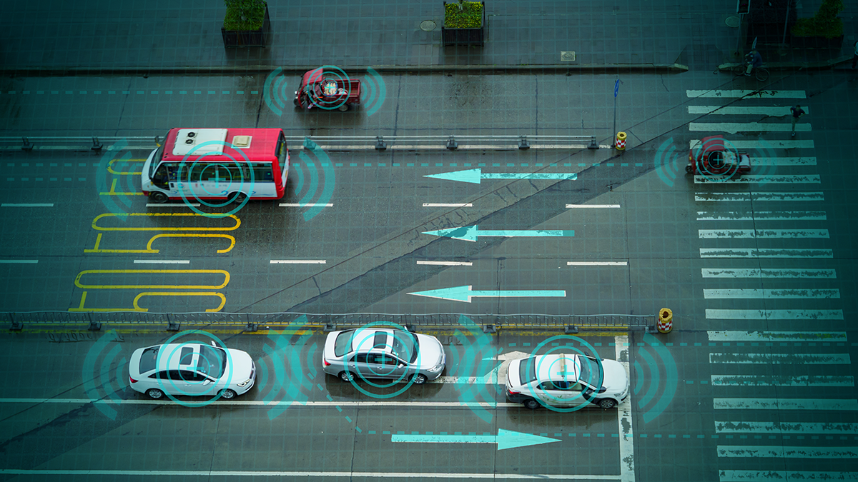
TRAFFIC MONITORING
Real –time traffic management relies on data collected from various sources, such as traffic cameras, sensors and GPS data from vehicles.

Slide 6

COMMUNICATION WITH THE PUBLIC
Real – time traffic management systems may communicate with the public through mobile apps, websites, and electronic signs, providing information about traffic conditions and alternate routes.

Slide 7
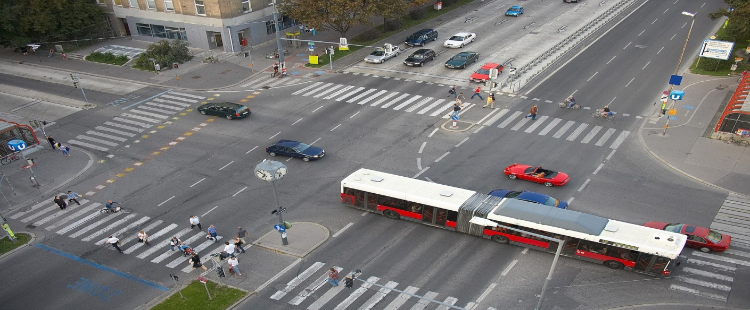
TRAFFIC SIGNAL OPTIMIZATION
Implement intelligent traffic signal systems that adjust signal timing based on real – time traffic conditions.

Slide 8

Smart signage

Slide 9
SMART SIGNAGE
Use electronics signage and dynamic message boards to provide real – time information to drivers, such as detour routes, lane closures, and parking availability.

Slide 10
CSS OF TRAFFIC MANAGEMENT
Traffic management systems typically rely on technologies like traffic lights, sensors, cameras and make real – time adjustments.
CSS is unrelated to these functionalities.

Slide 11
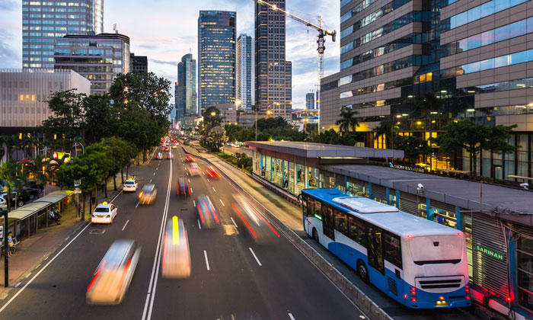
PUBLIC TRANSPORTATIONS INTEGRATION
Integrate public transportation services with the traffic management system to encourage the use of public transit.

Slide 12
TRAFFIC APPS AND INFORMATION SYSTEMS
Create mobile apps and information systems that provide commuters with real-time traffic updates and alternative routes.

Slide 13
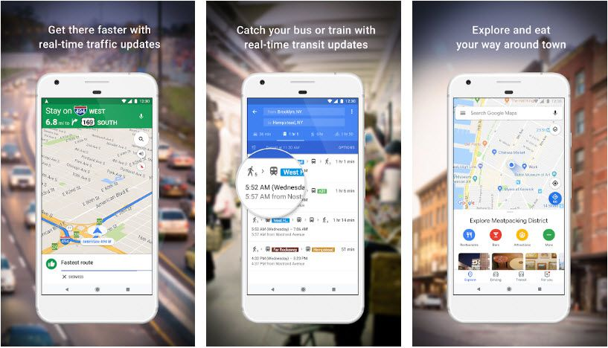
TRAFFIC APPS AND INFORMATION SYSTEMS

Slide 14
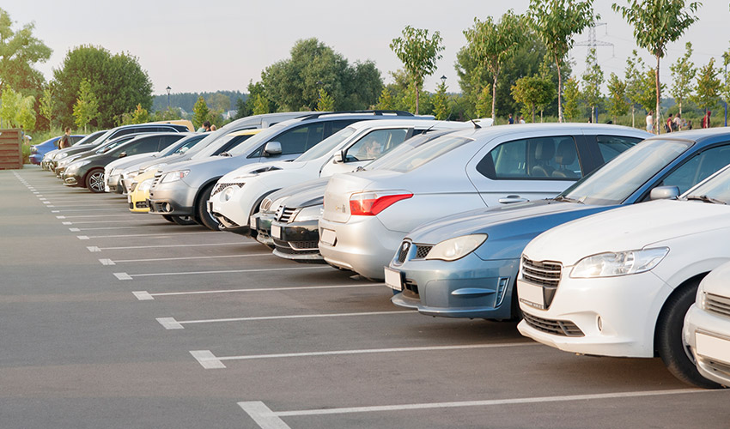
PARKING MANAGEMENT
Implement smart parking solutions to help drivers find available parking spaces, reducing the time spent searching for parking.

Slide 15
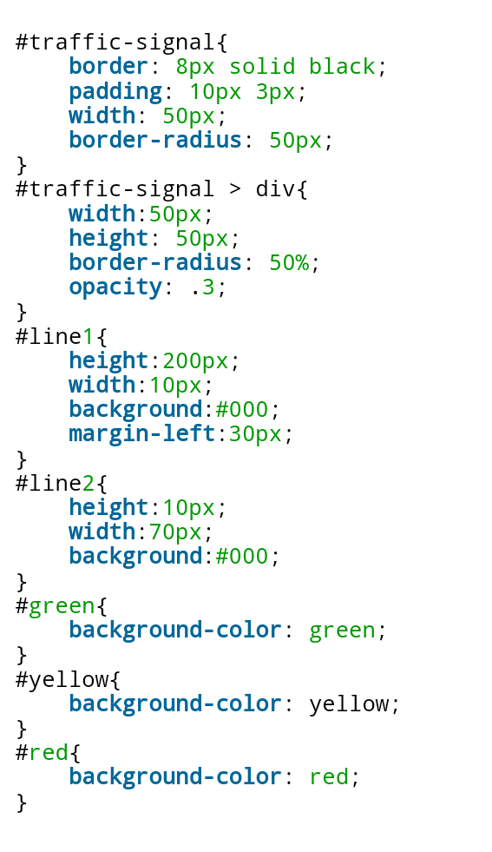
HTML PROTOCOL

Slide 16

ENVIRONMENT CONSIDERATIONS

Slide 17
ENVIRONMENT CONSIDERATIONS
Address environment concerns , such as reducing emissions and fuel consumption through traffic management strategies.

Slide 18


